Slide 1

Pex Technical Challenge – YouTube video analytics
Submitted by:
Rachit Mishra

Slide 2


Quick run-through of the process!
Meta table
user_id
analyst_challenge_data_meta.csv
duration
Created_at
category_id
pex_case
gid
Mapping column
gid
SQL Server database
views
History table
likes
dislikes
comments
analyst_challenge_data_history.csv
Updated_at

Slide 3
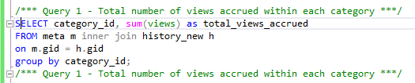

Insight 1 : Total number of views accrued within each category
Category 10(music) fetches over 5.4 billion views
Category 20(games) fetches the most – over 6.8 billion views

Slide 4
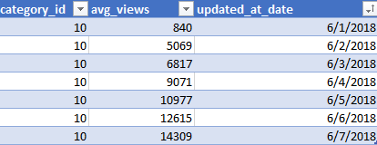
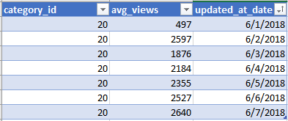
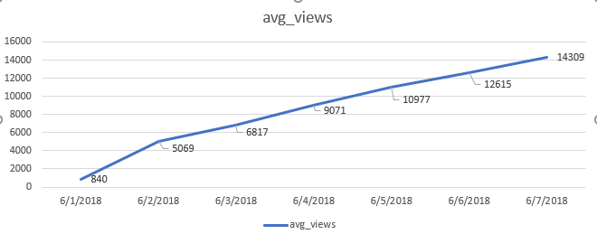
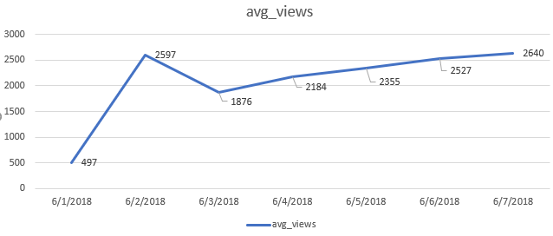
Insight 2 : Graph of daily views for an average video(within each category) note: refer to pex_case.py file for the related SQL query and subsequent conversion to two different .csv files(music & gaming)
Category 10: Music
Category 20: Gaming

Slide 5
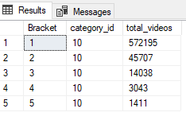
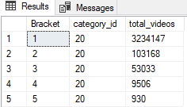
Insight 3 : Number of videos within each category with <1k, 1k-10k, 10k-100k, 100k-1m, 1m+ views note: Refer to pex_case.sql for the related query
Bracket look-up table
Bracket | Range of views
1 | <=1k
2 | 1k-10k
3 | 10k-100k
4 | 100k-1m
5 | 1m+
Category 10: Music
Category 20: Gaming

Slide 6
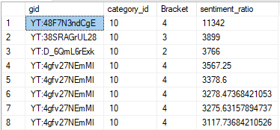
Insight 4(addl.): sentiment_ratio – likes/dislikes note: refer to pex_case.sql for the related query
A ratio of likes to dislikes is a key KPI in determining the general viewer sentiment towards the content(music/gaming).
Grouping this w.r.t different categories adds more depth to the insights.
Sentiment_ratio alone isn't enough to assess the performance of a video because a video might barely have 300 views and still have a sentiment ratio of for instance 10(10 likes to 1 dislike).
Hence, I grouped the sentiment_ratio w.r.t each Bracket that we created

Slide 7






Insight 5 :User_Engagement: Monitoring the volume of ‘comments’ alongside sentiment_ratio. Note: Refer to pex_case.sql for the related query
Preliminary observation:
Gaming(40 million+) generates more user engagement
than it's other counterpart - Music(23 million+)
Some videos have no user engagements(characterized by NULL values). A closer look at these videos revealed that many are either taken off/not available or were live streams that have now went offline. Hence, no user engagement.

Slide 8
Deliverables(submitted files)
PPT - Technical Challenge – YouTube video analytics.pptx
SQL file – pex_case.sql
Python file – pex_case.py
Additional:
GitHub repository containing all the project related files(repository containing databases, csv files, and other intermediary files

